Slide 1
The Mole Concept

Slide 2
Avogadro’s Number
Avogadro’s Number (symbol N) is the number of atoms in 12.01 grams of carbon.
Its numerical value is 6.02 × 10²³.
Therefore, a 12.01 g sample of carbon contains 6.02 × 10²³ carbon atoms.

Slide 3
The Mole
The mole (mol) is a unit of measure for an amount of a chemical substance.
A mole is Avogadro’s number of particles, that is 6.02 × 10²³ particles.
1 mol = Avogadro’s Number = 6.02 × 10²³ units
Use the mole relationship to convert between the number of particles and the mass of a substance.

Slide 4
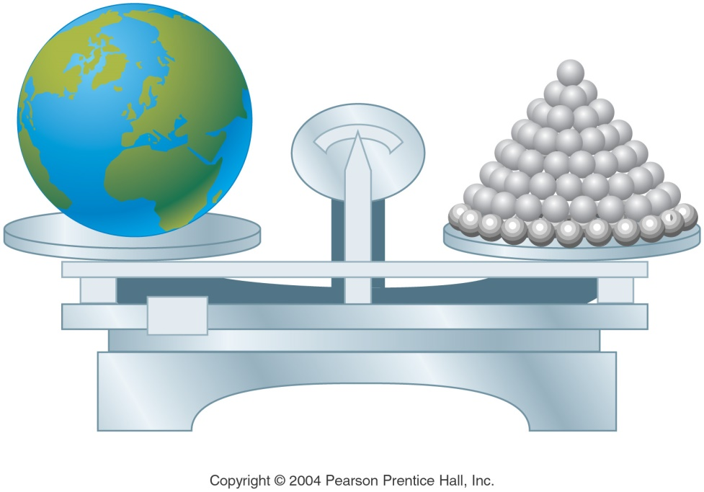
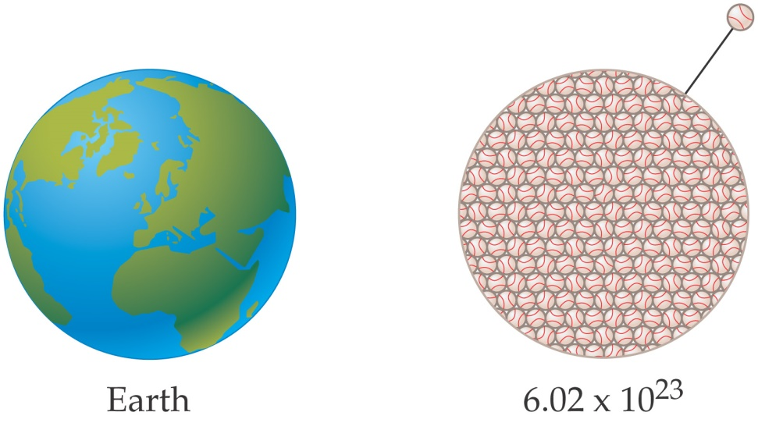
How Big Is a Mole?
The volume occupied by one mole of softballs would be about the size of the Earth.
One mole of Olympic shot put balls has about the same mass as the Earth.

Slide 5
Mole Calculations
Unit Analysis Method
Steps:
Write down the unit asked for
Write down the given value
Apply unit factor(s) to convert the given units to the desired units

Slide 6
Mole Calculations
How many sodium atoms are in 0.120 mol Na?
Step 1: Unit asked for: atoms of Na
Step 2: Given 0.120 mol Na
Step 3: Apply the unit factor(s) mole Na = 6.02 × 10²³ atoms Na
6.02 × 10²³ atoms Na
0.120 mol Na ×
= 7.22 × 10²² atoms Na
1 mol Na

Slide 7
Mole Calculations
How many moles of potassium are in 1.25 × 10²¹ atoms K?
Step 1: Unit asked for: moles K
Step 2: Given 1.25 × 10²¹ atoms K
Step 3: Apply the unit factor(s) 1 mole K = 6.02 × 10²³ atoms K
1 mol K
1.25 × 10²¹ atoms K ×
= 2.08 × 10⁻³ mol K
6.02 × 10²³ atoms K

Slide 8
Molar Mass
The atomic mass of any substance expressed in grams is the molar mass (MM) of that substance.
The atomic mass of iron is 55.85 amu.
Therefore, the molar mass of iron is 55.85 g/mol.
Since oxygen occurs naturally as a diatomic, O₂, the molar mass of oxygen gas is 2 times 16.00 g or 32.00 g/mol.

Slide 9
Calculating Molar Mass
The molar mass of a substance is the sum of the molar masses of each element.
What is the molar mass of magnesium nitrate, Mg(NO₃)₂?
The sum of the atomic masses is:
24.31 + 2(14.01 + 16.00 + 16.00 + 16.00) =
24.31 + 2(62.01) = 148.33 amu
The molar mass for Mg(NO₃)₂ is 148.33 g/mol.

Slide 10
Mole into g Calculations
Use the molar mass of a compound to convert between grams of a substance and moles or particles of a substance.
6.02 × 10²³ particles = 1 mol = molar mass
To convert particles to mass, first convert particles to moles and then convert moles to mass.

Slide 11
Mass-Mole Calculations
What is the mass of 1.33 moles of titanium (Ti)?
Want grams, have 1.33 moles of titanium.
Use the molar mass of Ti: 1 mol Ti = 47.88 g Ti
47.88 g Ti
1.33 mole Ti ×
= 63.7 g Ti
1 mole Ti

Slide 12
Mass-Mole Calculations
What is the mass of 2.55 × 10²³ atoms of lead?
We want grams, we have atoms of lead.
Use Avogadro’s number and the molar mass of Pb
1 mol Pb
207.2 g Pb
2.55 × 10²³ atoms Pb ×
×
6.02×10²³ atoms Pb
1 mole Pb
= 87.8 g Pb

Slide 13
Mass-Mole Calculations
How many O₂ molecules are present in 0.470 g of oxygen gas?
We want molecules O₂, we have grams O₂.
Use Avogadro’s number and the molar mass of O₂
1 mol O₂
6.02×10²³ molecules O₂
0.470 g O₂ ×
×
32.00 g O₂
1 mole O₂
8.84 × 10²¹ molecules O₂

